Slide 1



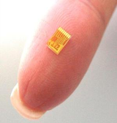
On the Verge of A Disruptive Century: Breakthroughs
Gene Sequencing and Biotechnology
Ubiquitous Computing
Smaller, Faster, Cheaper Sensors
Faster Communication

Slide 2

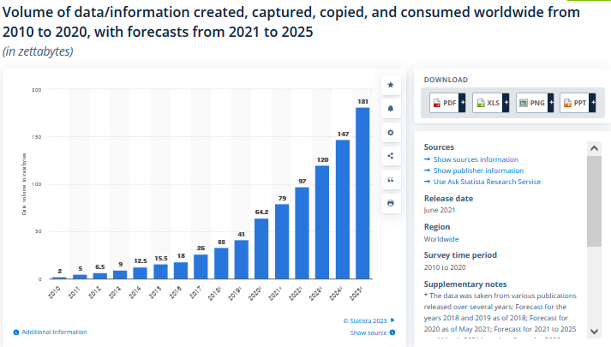
A Common Theme is Data
The amount of data is only growing… 1.2 Zettabytes (1ZB = 10²¹ B or 1 Billion TB) in 2010

Slide 3
We Live in a World of Data
Nearly 500 Exabytes per day are generated by the Large Hadron Collider experiments (not all recorded!)
2.9 million emails are sent every second
20 hours of video are uploaded to YouTube every minute
24 PBs of data are processed by Google every day
50 million tweets are generated per day
700 billion total minutes are spent on Facebook each month
72.9 items are ordered on Amazon every second

Slide 4
Data and Big Data
The value of data as an organizational asset is widely recognized
Data is literally exploding and is occurring along three main dimensions
“Volume” or the amount of data
“Velocity” or the speed of data
“Variety” or the range of data types and sources
What is Big Data?
It is the proliferation of data that floods organizations on a daily basis
It is high volume, high velocity, and/or high variety information assets
It requires new forms of processing to enable fast mining, enhanced decision-making, insight discovery and process optimization

Slide 5
What Do We Do With Data and Big Data?
Store
Query
Encrypt
…. and more!
Mine
Share
We want to do these seamlessly and fast...

Slide 6










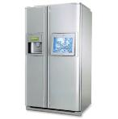
Using Diverse Interfaces & Devices
Mobile Devices
Computers
…and even appliances
Consumer Electronics
Personal Monitors and Sensors
We also want to access, share and process our data from all of our devices, anytime, anywhere!

Slide 7







Data is Becoming Critical to Our Lives
Health
Domains of Data
Science
Education
Work
Environment
Finance
… and more

Slide 8
Why Studying Databases?
Data is everywhere and is critical to our lives
Data need to be recorded, maintained, accessed and manipulated correctly, securely, efficiently and effectively
At the “low end”: scramble to web-scale (a mess!)
At the “high end”: scientific applications
Database management systems (DBMSs) are indispensable software for achieving such goals
The principles and practices of DBMSs are now an integral part of computer science curricula
They encompass OS, languages, theory, AI, multimedia, and logic, among others
As such, the study of database systems can prove to be richly rewarding in more ways than one!

Slide 9
Purpose of Database Systems
In the early days, database applications were built directly on top of file systems, which leads to:
Data redundancy and inconsistency: data is stored in multiple file formats resulting induplication of information in different files
Difficulty in accessing data
Need to write a new program to carry out each new task
Data isolation
Multiple files and formats
Integrity problems
Integrity constraints (e.g., account balance > 0) become “buried” in program code rather than being stated explicitly
Hard to add new constraints or change existing ones
Notes:
9

Slide 10
Purpose of Database Systems (Cont.)
Atomicity of updates
Failures may leave database in an inconsistent state with partial updates carried out
Example: Transfer of funds from one account to another should either complete or not happen at all
Concurrent access by multiple users
Concurrent access needed for performance
Uncontrolled concurrent accesses can lead to inconsistencies
Ex: Two people reading a balance (say 100) and updating it by withdrawing money (say 50 each) at the same time
Security problems
Hard to provide user access to some, but not all, data
Database systems offer solutions to all the above problems
Notes:
10

Slide 11
Database Applications Examples
Enterprise Information
Sales: customers, products, purchases
Accounting: payments, receipts, assets
Human Resources: Information about employees, salaries, payroll taxes.
Manufacturing: management of production, inventory, orders, supply chain.
Banking and finance
customer information, accounts, loans, and banking transactions.
Credit card transactions
Finance: sales and purchases of financial instruments (e.g., stocks and bonds; storing real-time market data
Universities: registration, grades
Notes:
11

Slide 12
Database Applications Examples (Cont.)
Airlines: reservations, schedules
Telecommunication: records of calls, texts, and data usage, generating monthly bills, maintaining balances on prepaid calling cards
Web-based services
Online retailers: order tracking, customized recommendations
Online advertisements
Document databases
Navigation systems: For maintaining the locations of varies places of interest along with the exact routes of roads, train systems, buses, etc.
Notes:
12

Slide 13
Course Objectives
In this course we aim at studying:
Big Data, Hadoop, BigTable, parallel and distributed DBMSs, NoSQL and NewSQL databases
How to construct buffer and disk space managers, query optimizers, and concurrency and crash recovery managers for DBMSs
How to refine and speed up data retrieval and manipulation
How to query and manipulate databases
How to design and implement databases from ‘cradle-to-grave’
Application-Centric
Systems-Centric & Theory-Centric
Advanced Topics
(A Brief Overview)

Slide 14
A bit of History
Computer initially used for computational/ engineering purposes
Commercial applications introduced File Processing System

Slide 15
File Processing System
A collection of application programs that perform services for the end-users such as production of reports
Each program defines and manages its own data

Slide 16
File Processing Systems
Library
Examination
Registration
Library
Applications
Examination
Applications
Registration
Applications
Library
Data
Files
Examination
Data
Files
Registration
Data
Files
Program and Data Interdependence

Slide 17
File Processing Systems
Library
Examination
Registration
Reg_Number
Reg_Number
Reg_Number
Name
Name
Name
Father Name
Address
Father Name
Books Issued
Class
Phone
Fine
Semester
Address
Grade
Class

Slide 18
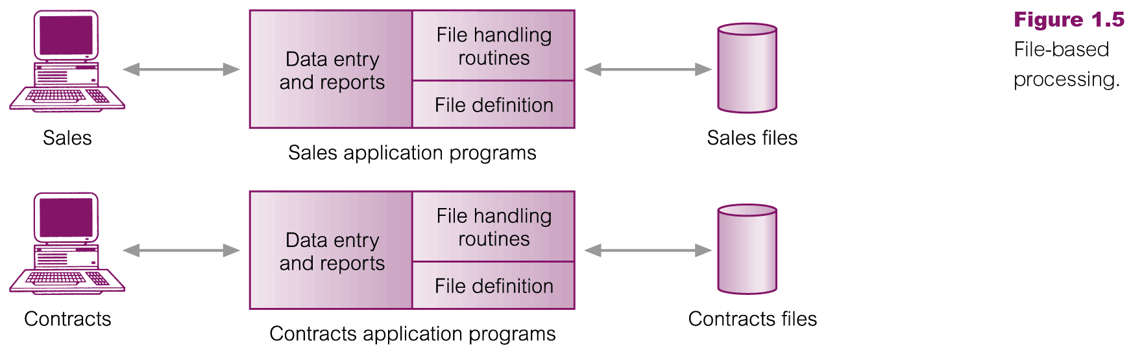
Files Based Processing

Slide 19
Disadvantages of File Processing
Program-Data Dependence
File structure is defined in the program code.
All programs maintain metadata for each file they use
Duplication of Data (Data Redundancy)
Different systems/programs have separate copies of the same data
Same data is held by different programs.
Wasted space and potentially different values and/or different formats for the same item.
Limited Data Sharing
No centralized control of data
Programs are written in different languages, and so cannot easily access each other’s files.

Slide 20
Disadvantages of File Processing
Lengthy Development Times
Programmers must design their own file formats
Excessive Program Maintenance
80% of of information systems budget
Vulnerable to Inconsistency
Change in one table need changes in corresponding tables as well otherwise data will be inconsistent

Slide 21
Problems with Data Dependency
Each application programmer must maintain their own data
Each application program needs to include code for the metadata of each file
Each application program must have its own processing routines for reading, inserting, updating and deleting data
Lack of coordination and central control
Non-standard file formats

Slide 22
Problems with Data Redundancy
Waste of space to have duplicate data
Causes more maintenance headaches
The biggest problem:
When data changes in one file, could cause inconsistencies (Vulnerable to Inconsistency)
Compromises data integrity (data reliability)

Slide 23
SOLUTION: The DATABASE Approach
Central repository of shared data
Data is managed by a controlling agent
Stored in a standardized, convenient form
This requires a
Database and Database Management System (DBMS)

Slide 24

Advantages of Database Approach
Library
Examination
Registration
Library
Applications
Examination
Applications
Registration
Applications
Database
Management
System
- Data Sharing
- Data Independence
University
Students
Database
- Controlled Redundancy
- Better Data Integrity

Slide 25
The concept of a shared organizational database
Management
Marketing
Planning
Control
Sales
Product
Development
Corporate
Database
Accounting
Manufacturing
Accounts
Receivable
Accounts
Payable
Scheduling
Production

Slide 26
A Motivating Scenario
PSTU has a “large” collection of data (say 500GB) on employees, students, universities, research centers, etc.,
This data is accessed concurrently by several people
Queries on data must be answered quickly
Changes made to the data by different users must be applied consistently
Access to certain parts of data (e.g., salaries) must be restricted
This data should survive system crashes/failures
Performance (Concurrency Control)
Performance (Response Time)
Correctness (Consistency)
Correctness (Security)
Correctness (Durability and Atomicity)

Slide 27
Managing Data using File Systems
What about managing PSTU data using local file systems?
Files of fixed-length and variable-length records as well as formats
Main memory vs. disk
Computer systems with 32-bit addressing vs. 64-bit addressing schemes
Special programs (e.g., C++ and Python programs) for answering user questions
Special measures to maintain atomicity
Special measures to maintain consistency of data
Special measures to maintain data isolation
Special measures to offer software and hardware fault-tolerance
Special measures to enforce security policies in which different users are granted different permissions to access diverse subsets of data
This becomes tedious and inconvenient, especially at large-scale, with evolving/new user queries and higher probability of failures!

Slide 28
List of Topics
Considered: a reasonably critical and
comprehensive understanding.
Thoughtful: fluent, flexible and efficient
understanding.
Masterful: a powerful and illuminating
understanding.
.1.
The Entity-Relationship Model
.2.
The Relational Model
.3.
Relational Algebra and Calculus
.4.
SQL
.5.
Data Storage and Organization
.6.
Tree-Based and Hash-Based Indexing
.7.
Query Evaluation and Optimization
.9.
Concurrency Control and Crash Recovery
.10.
Advanced Topics: Distributed Databases, Hadoop, and NoSQL and NewSQL Databases

Slide 29
Learning Outcomes
After finishing this course you will be able to:
1. Describe a wide range of data involved in real-world organizations using the entity-relationship (ER) data model
2. Explain how to translate an ER diagram into a relational database
3. Analyze and apply a formal query language, relational calculus and algebra
4. Indicate how SQL builds upon relational calculus and algebra and effectively apply SQL to create, query and manipulate relational databases
5. Design and develop multi-tiered, full-fledged standalone and web-based applications with back-end databases
6. Appreciate how DBMSs create, manipulate and manage files of fixed-length and variable-length records on disks

Slide 30
Learning Outcomes
After finishing this course you will be able to:
7. Create and operate various static and dynamic tree-based (e.g., ISAM and B+ trees) and hash-based (e.g., extendable and linear hashing) indexing schemes
8. Explain and evaluate various algorithms for relational operations (e.g., join) using techniques such as iteration, indexing and partitioning
9. Analyze and apply different query evaluation plans and describe the various tasks of a typical relational query optimizer
10. Describe how transactions can be interleaved correctly, and indicate how a DBMS can ensure atomicity and durability when systems fail or entirely crash
11. Identify alternative architectures for distributed databases, and describe how data can be partitioned and distributed across networked nodes of a DBMS
12. Appreciate the scale of Big Data, discuss some popular analytics engines for Big Data processing and denote the applicability of NoSQL databases for Big Data storage

Slide 31
Teaching Methods, Assignments and Projects
Lectures
Motivate learning
Provide a framework or roadmap to organize the information of the course
Explain subjects and reinforce the critical big ideas
Recitations
Get you to reveal what you do not understand, so we can help you
Allow you to practice skills you will need to become an expert
5 Assignments
We will have 5 assignments which involve problem solving and span most of the topics that we discuss in the class
Projects
We will have 3 projects which involve using SQL, Oracle

Slide 32
Data Base Management Systems
A special software is accordingly needed to make the preceding tasks easier
This software is known as Data Base Management System (DBMS)
DBMSs provide automatic:
Data independence
Efficient data access
Data integrity and security
Data administration
Concurrent access and crash recovery
Reduced application development and tuning time

Slide 33
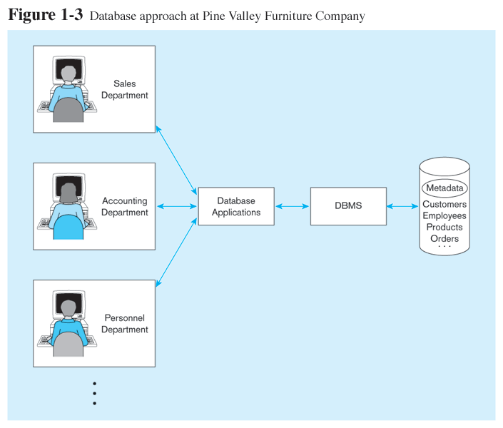
Database Management System
DBMS manages data resources like an operating system manages hardware resources

Slide 34



An
Example
▪ UNIVERSITY database
▪ Information concerning students, courses,
and
grades in a university
▪ Data records
▪ STUDENT
▪ COURSE
▪ SECTION
▪ GRADE_REPORT
▪ PREREQUISITE
environment
Copyright © 2011 Ramez Elmasri and Shamkant Navathe

Slide 35
An
Example
(cont'd.)
▪ Specify structure of records of each file by
specifying data type for each
element
data
▪ String of
▪ Integer
▪ Etc.
alphabetic
characters
Copyright © 2011 Ramez Elmasri and Shamkant Navathe

Slide 36
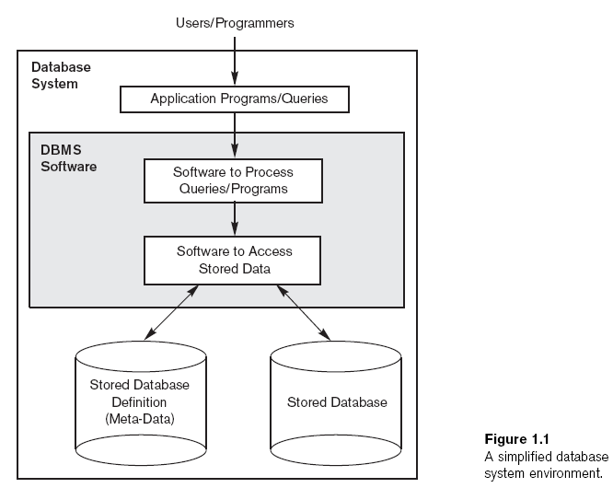
Copyright © 2011 Ramez Elmasri and Shamkant Navathe

Slide 37
An
Example (cont'd.)
▪ Construct UNIVERSITY database
▪ Store data to represent each student, course,
section, grade report, and prerequisite
record in appropriate file
▪ Relationships among the records
▪ Manipulation involves querying and updating
as
a
Copyright © 2011 Ramez Elmasri and Shamkant Navathe

Slide 38
An
Example
(cont'd.)
▪ Examples of queries:
▪ Retrieve the transcript
▪ List the names of students who took the
section of the ‘Database’ course offered
2008 and their grades in that section
in fall
▪ List the prerequisites
of
the
‘Database’
course
Copyright © 2011 Ramez Elmasri and Shamkant Navathe

Slide 39
An
Example
(cont'd.)
▪ Examples of updates:
▪ Change the class of ‘Smith’ to sophomore
▪ Create a new section for the ‘Database’ course
for this semester
▪ Enter a
section
grade
of last
of ‘A’ for ‘Smith’
semester
in
the
‘Database’
Copyright © 2011 Ramez Elmasri and Shamkant Navathe

Slide 40
An Example
(cont'd.)
▪ Phases for designing a database:
▪ Requirements specification
▪ Conceptual design
▪ Logical design
and
analysis
▪ Physical
design
Copyright © 2011 Ramez Elmasri and Shamkant Navathe

Slide 41
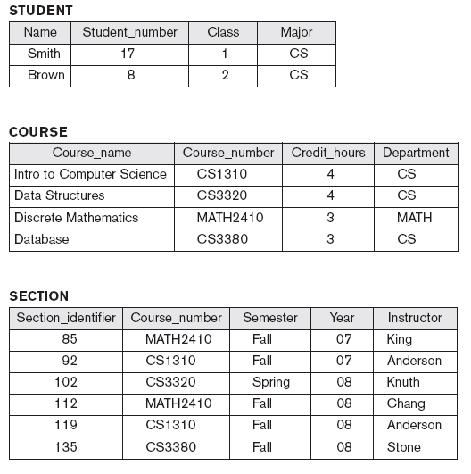
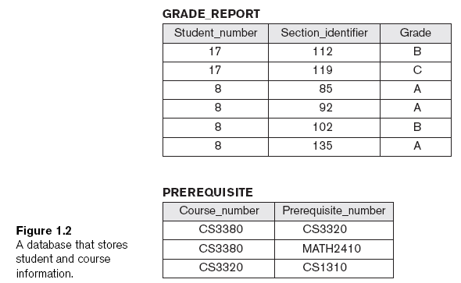
Copyright © 2011 Ramez Elmasri and Shamkant Navathe

Slide 42
Some Definitions
A database is a collection of data which describes one or many real-world enterprises
E.g., a university database might contain information about entities like students and courses, and relationships like a student enrollment in a course
A DBMS is a software package designed to store and manage databases
E.g., DB2, Oracle, MS SQL Server, MySQL and Postgres
A database system = (Big) Data + DBMS + Application Programs

Slide 43
Definitions of Database
Def 1: Database is an organized collection of logically related data
Def 2: A database is a shared collection of logically related data that is stored to meet the requirements of different users of an organization
Def 3: A database is a self-describing collection of integrated records
Def 4: A database models a particular real world system in the computer in the form of data

Slide 44
Definitions
Data: stored representations of meaningful objects and events or
Referred to facts concerning objects and events that could be recorded and stored on computer media
Structured: numbers, text, dates
Unstructured: images, video, documents
Information: data processed to increase knowledge in the person using the data
Metadata: data that describes the properties and context of user data

Slide 45
Data Models
The user of a DBMS is ultimately concerned with some real-world enterprises (e.g., a University)
The data to be stored and managed by a DBMS describes various aspects of the enterprises
E.g., The data in a university database describes students, faculty and courses entities and the relationships among them
A data model is a collection of high-level data description constructs that hide many low-level storage details
A widely used data model called the entity-relationship (ER) model allows users to pictorially denote entities and the relationships among them

Slide 46
The Relational Model
The relational model of data is one of the most widely used models today
The central data description construct in the relational model is the relation
A relation is basically a table (or a set) with rows (or records or tuples) and columns (or fields or attributes)
Every relation has a schema, which describes the columns of a relation
Conditions that records in a relation must satisfy can be specified
These are referred to as integrity constraints

Slide 47
The Relational Model: An Example
Let us consider the student entity in a university database
Students Schema
Students(sid: string, name: string, login: string, dob: string, gpa: real)
An attribute, field or column
Integrity Constraint: Every student has a unique sid value
sid | name | login | dob | gpa
512412 | Khaled | khaled@cse.pstu.ac.bd | 18-9-1995 | 3.5
512311 | Jones | jones@cse.pstu.ac.bd | 1-12-1994 | 3.2
512111 | Maria | maria@cse.pstu.ac.bd | 3-8-1995 | 3.85
A record, tuple or row
An instance of a Students relation

Slide 48
Levels of Abstraction
The data in a DBMS is described at three levels of abstraction, the conceptual (or logical), physical and external schemas
The conceptual schema describes data in terms of a specific data model (e.g., the relational model of data)
The physical schema specifies how data described in the conceptual schema are stored on secondary storage devices
The external schema (or views) allow data access to be customized at the level of individual users or group of users (views can be 1 or many)
View 1
View 2
View 3
Conceptual Schema
Physical Schema
Disk

Slide 49
Views
A view is conceptually a relation
Records in a view are computed as needed and usually not stored in a DBMS
Example: University Database
Conceptual Schema | Physical Schema | External Schema (View)
Students(sid: string, name: string, login: string, dob: string, gpa:real) Courses(cid: string, cname:string, credits:integer) Enrolled(sid:string, cid:string, grade:string) | Relations stored as heap files Index on first column of Students | Students can be allowed to find out course enrollments: Course_info(cid: string, enrollment: integer)
Can be computed from the relations in the conceptual schema (so as to avoid data redundancy and inconsistency).

Slide 50
Iterating: Data Independence
One of the most important benefits of using a DBMS is data independence
With data independence, application programs are insulated from how data are structured and stored
Data independence entails two properties:
Logical data independence: users are shielded from changes in the conceptual schema (e.g., add/drop a column in a table)
Physical data independence: users are shielded from changes in the physical schema (e.g., add index or change record order)

Slide 51
Queries in a DBMS
The ease with which information can be queried from a database determines its value to users
A DBMS provides a specialized language, called the query language, in which queries can be posed
The relational model supports powerful query languages
Relational calculus: a formal language based on mathematical logic
Relational algebra: a formal language based on a collection of operators (e.g., selection and projection) for manipulating relations
Structured Query Language (SQL):
Builds upon relational calculus and algebra
Allows creating, manipulating and querying relational databases
Can be embedded within a host language (e.g., Java)

Slide 52
Concurrent Execution and Transactions
An important task of a DBMS is to schedule concurrent accesses to data so as to improve performance
When several users access a database concurrently, the DBMS must order their requests carefully to avoid conflicts
E.g., A check might be cleared while account balance is being computed!
DBMS ensures that conflicts do not arise via using a locking protocol
Shared vs. Exclusive locks
T1
T2
R(A)
W(A)
R(C)
W(C)
An atomic sequence of database actions (read/writes)
is referred to as “transaction”
R(B)
W(B)

Slide 53
Ensuring Atomicity
Transactions can be interrupted before running to completion for a variety of reasons (e.g., due to a system crash)
DBMS ensures atomicity (all-or-nothing property) even if a crash occurs in the middle of a transaction
This is achieved via maintaining a log (i.e., history) of all writes to the database
Before a change is made to the database, the corresponding log entry is forced to a safe location (this protocol is called Write-Ahead Log or WAL)
After a crash, the effects of partially executed transactions are undone using the log

Slide 54
The Architecture of a Relational DBMS
Web Forms
Application Front Ends
SQL Interface
SQL Commands
Plan Executer
Parser
Query Evaluation Engine
Operator Evaluator
Optimizer
Transaction Manager
Files and Access Methods
Recovery Manager
Buffer Manager
Lock Manager
Disk Space Manager
Concurrency Control
DBMS
Database
Index Files
System Catalog
Data Files

Slide 55
People Who Work With Databases
There are five classes of people associated with databases:
End users
Store and use data in DBMSs
Usually not computer professionals
Application programmers
Develop applications that facilitate the usage of DBMSs for end-users
Computer professionals who know how to leverage host languages, query languages and DBMSs altogether
Database Administrators (DBAs)
Design the conceptual and physical schemas
Ensure security and authorization
Ensure data availability and recovery from failures
Perform database tuning
Implementers
Build DBMS software for vendors like IBM and Oracle
Computer professionals who know how to build DBMS internals
Researchers
Innovate new ideas which address evolving and new challenges/problems

Slide 56
The Architecture of a Relational DBMS
End Users (e.g., university staff, travel agents, etc.)
Application Programmers & DBAs
Web Forms
Application Front Ends
SQL Interface
SQL Commands
Implementers and Researchers
Plan Executer
Parser
Query Evaluation Engine
Operator Evaluator
Optimizer
Transaction Manager
Files and Access Methods
Recovery Manager
Buffer Manager
Lock Manager
Disk Space Manager
Concurrency Control
DBMS
Database
Index Files
System Catalog
Data Files

Slide 57
What are we still working on?
Why Are You Taking this Course?
Relational DBMS was invented in early 70’s, and now 50+ billion mature industry
What are we still working on?
Database
http://www.youtube.com/watch?v=Q2GMtIuaNzU
Big data
http://www.youtube.com/watch?v=LrNlZ7-SMPk
Are you interested more in being
An IT guru at Goldman-Sachs or Boeing?
A system developer at Oracle or Google?
A data scientist at Facebook or Uber?
A DB pro or researcher in Microsoft research or IBM research?
A professor exploring the most exciting, and fastest growing area in CS?

Slide 58
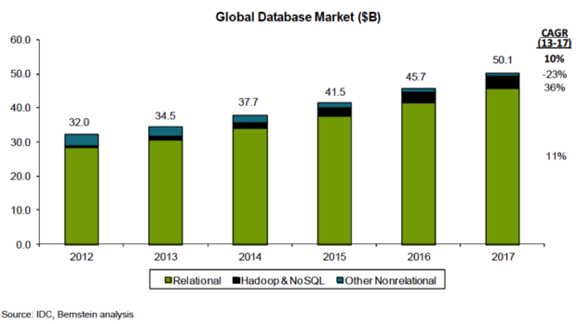
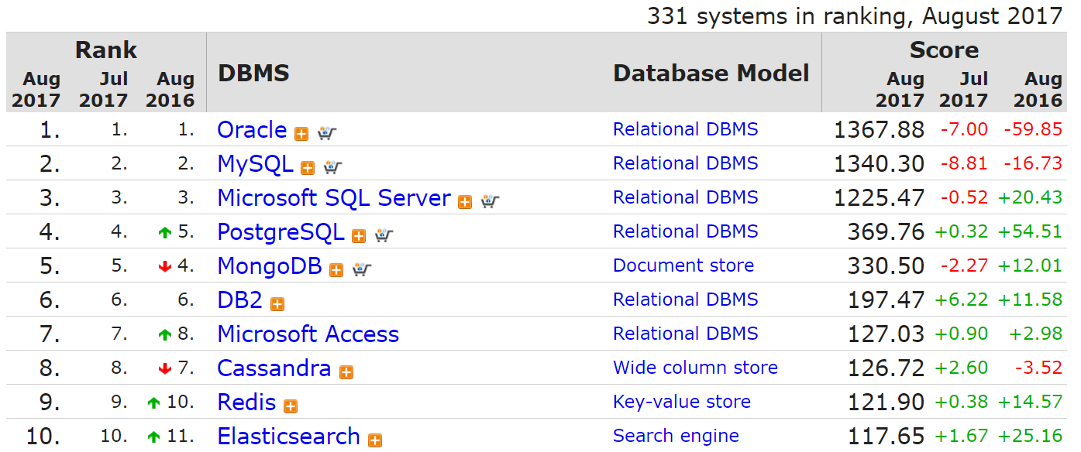
In Industry

Slide 59
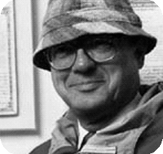
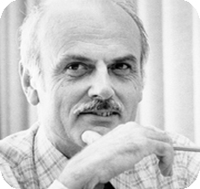
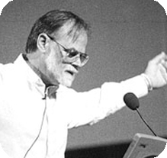

In Science – Turing Awardees
The ACM A.M. Turing Award is an annual prize given by the Association for Computing Machinery (ACM) to an individual selected for contributions "of lasting and major technical importance to the computer field"
CHARLES BACHMAN, 1973
- Known for his work in the early development of database management systems.
Edgar codd, 1981
-Invented Relational model (RM), the theoretical basis for relational databases and relational database management systems.
James Gray, 1998
-For seminal contributions to database and transaction processing research
Michael stonebraker, 2014
-Research and products are central to many relational database systems

Slide 60
The Grand Challenges of Data Management
What is the ultimately advanced DB?
Data of all sorts--- Prevalent on the Web!
What have you been searching lately?
What you search is what you want?
New challenges naturally arise
structured vs. unstructured data
querying vs. analysis vs. mining vs. learning
closed “base” vs. the open Web

Slide 61
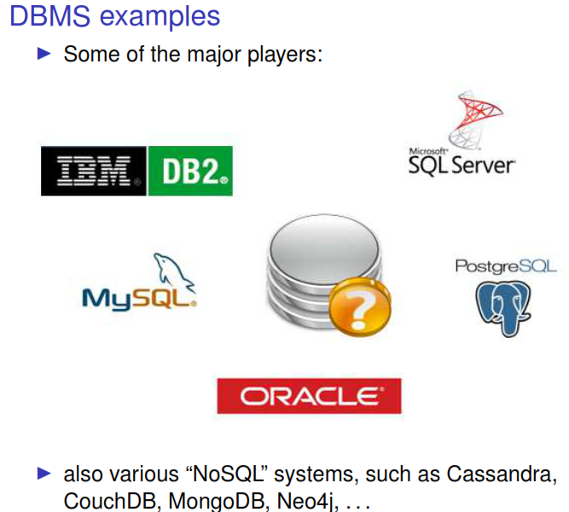

Slide 62
Summary
We live in a world of data
The explosion of data is occurring along the 3Vs dimensions
DBMSs are needed for ensuring logical and physical data independence and ACID properties, among others
The data in a DBMS is described at three levels of abstraction
A DBMS typically has a layered architecture

Slide 63
Summary
Studying DBMSs is one of the broadest and most exciting areas in computer science!
This course provides an in-depth treatment of DBMSs with an emphasis on how to design, create, refine, use and build DBMSs and real-world enterprise databases
Various classes of people who work with databases hold responsible jobs and are well-paid!

